Slide 1

WEB TECHNOLOGIES
CSS – Box Model
and Position Property
Vinay Joshi
Department of
Computer Science and Engineering

Slide 2

CSS – Box Model and Position Property
Element support for styling
They are used to group together a chunk of HTML and hook some information onto that chunk
The difference between span and div is that a span element is in-line and usually used for a small chunk of HTML inside a line (such as inside a paragraph) whereas a div (division) element is block-line (which is basically equivalent to having a line-break before and after it) and used to group larger chunks of code.

Slide 3
CSS – Box Model and Position Property
Element support for styling
There are two elements used commonly to style specific parts of a webpage
<span>
To apply style to a part of a paragraph
<div>
To apply style to a set of elements or paragraphs

Slide 4
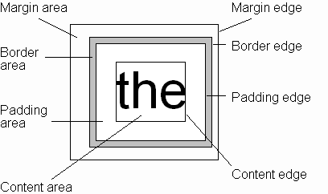
CSS – Box Model and Position Property
Box Model
Every rendered element occupies a box:
(or outer edge)
(or inner edge)

Slide 5
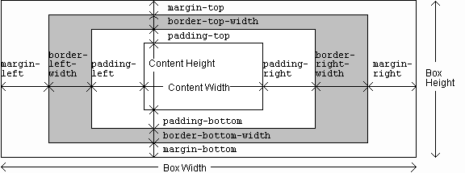
CSS – Box Model and Position Property
Box Model - Components

Slide 6
CSS – Box Model and Position Property
Position Property
By default, the browser determines the positioning of each element
CSS introduced the position property and a capability to control how and where page elements are displayed
Position property values:
Absolute
Relative

Slide 7

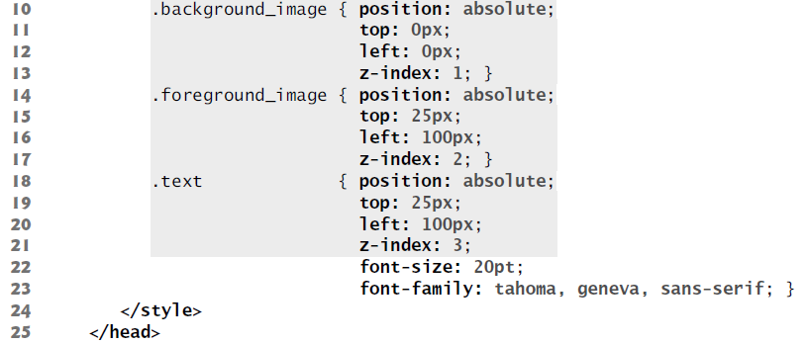
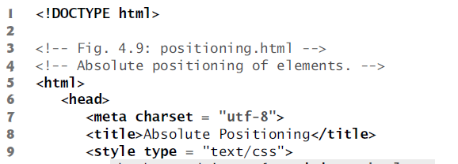
Positioning Elements: Absolute Positioning, z-index
Before CSS, controlling element positioning in HTML documents was difficult—the browser determined positioning.
CSS introduced the position property and a capability called absolute positioning, which gives you greater control over how document elements are displayed.

Slide 8
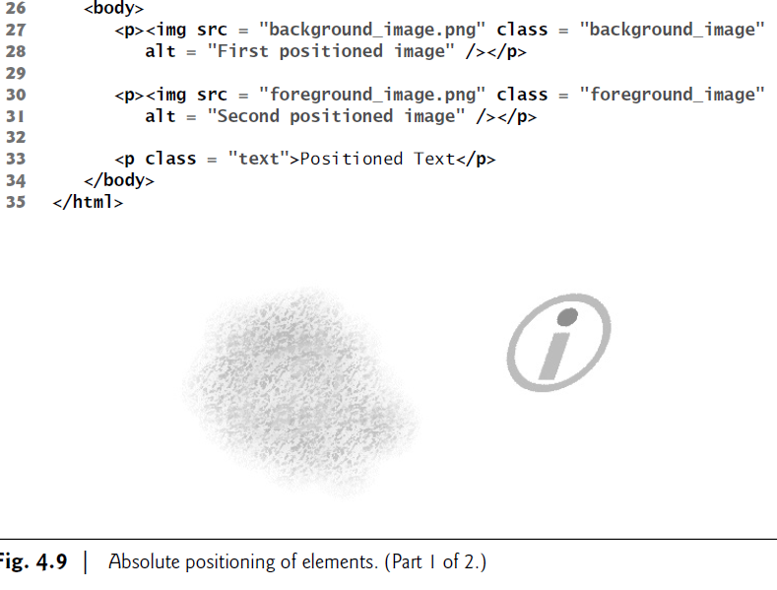

Slide 9
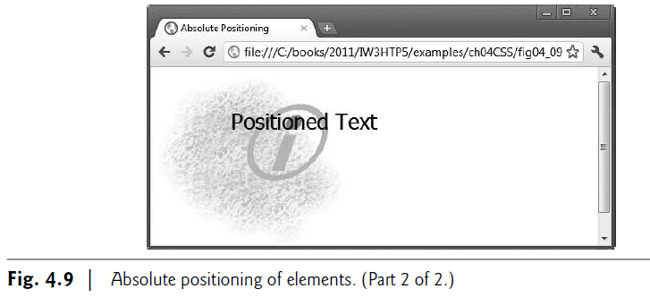
The z-index property allows you to layer overlapping elements.
Elements that have higher z-index values are displayed in front of elements with lower z-index values.
If you do not specify a z-index or if elements have the same z-index value, the elements are placed from background to foreground in the order in which they’re encountered in the document.
The default z-index value is 0.

Slide 10
Positioning Elements: Relative Positioning, span
Setting the position property to relative, as in class super (lines 15–16), lays out the element on the page and offsets it by the specified top, bottom, left or right value.
Class super (lines 15–16) lays out the text at the end of the sentence as superscript and Class sub (lines 17–18) lays out the text as subscript relative to the other text.
Class shiftleft (lines 19–20) shifts the text at the end of the sentence left and Class shiftright (lines 21–22) shifts the text right.
The span’s height determines how much vertical space it will occupy.
The font-size determines the size of the text inside the span.

Slide 11

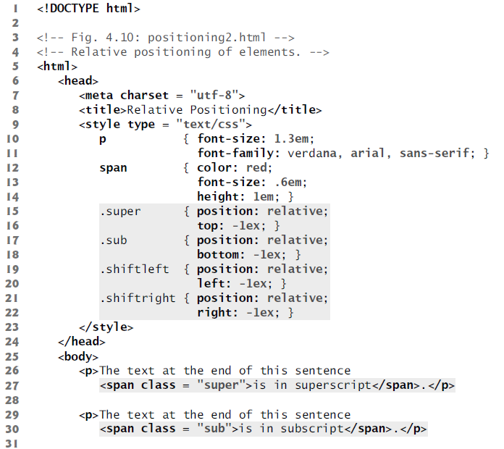
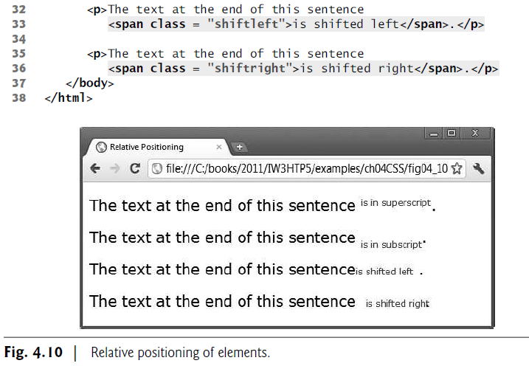

Slide 12
Element span is a grouping element—by default, it does not apply any formatting to its contents. Its primary purpose is to apply CSS rules or id attributes to a section of text.
Element span is an inline-level element—it does not change the flow of elements in the document.
Examples of inline elements include span, img, a, em and strong.

Slide 13
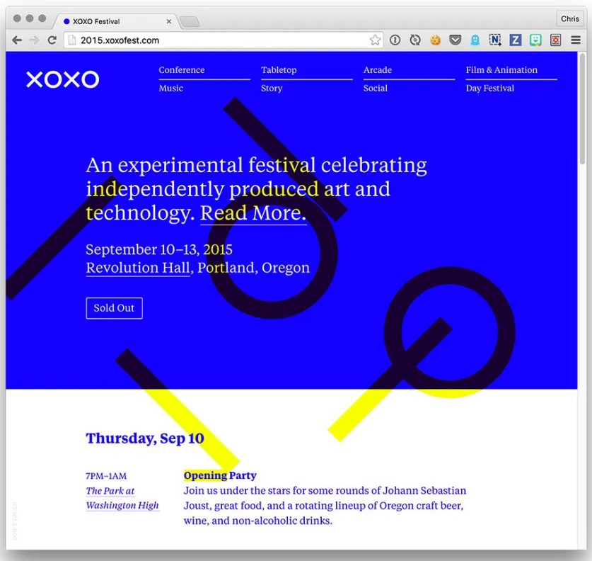
CSS – Box Model and Position Property
Background
CSS provides control over the backgrounds of block-level elements.
CSS can set a background color or add background images to HTML5 elements.
Different properties
background-image
background-position
background-repeat
background-attachment

Slide 14
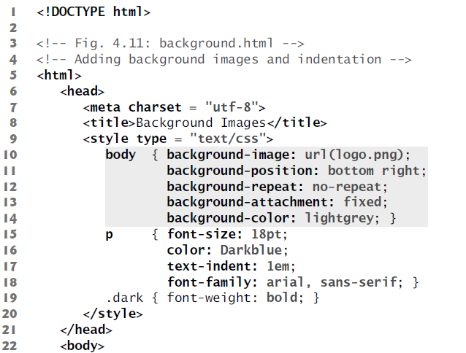
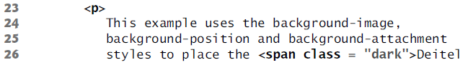
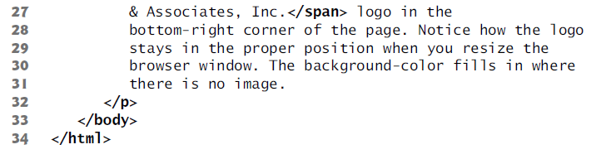

Slide 15
background-image Property
specifies the image URL for the image logo.png in the format url(fileLocation).
background-position Property
places the image on the page.
The keywords top, bottom, center, left and right are used individually or in combination for vertical and horizontal positioning.
background-repeat Property
controls background image tiling, which places multiple copies of the image next to each other to fill the background.
Other values include
repeat (the default) to tile the image vertically and horizontally, repeat-x to tile the
image only horizontally or repeat-y to tile the image only vertically.

Slide 16
background-attachment: fixed Property
background-attachment: fixed , fixes the image in the position specified by background-position.
Scrolling the browser window will not move the image from its position. Default value is scroll.
text-indent property
to indent the first line of text in the element by a specified amount, in this case 1em.
font-style property
allows you to set text to none, italic or oblique

Slide 17
Element Dimensions
CSS rules can specify the actual dimensions of each page element.
Specifying the width and height of an Element
width of an element on screen should occupy 20 percent of the screen width.
The height of an element can be set similarly, using the height property.
This works only for block-level elements.
text-align Property
Most elements are left-aligned by default, but this alignment can be altered.
values for the text-align property include center-aligned, left and right.
overflow Property and Scroll Bars
One problem with setting both dimensions of an element is that the content inside the element can exceed the set boundaries.
we set the overflow property to scroll, a setting that adds scroll bars if the text overflows the boundaries.

Slide 18
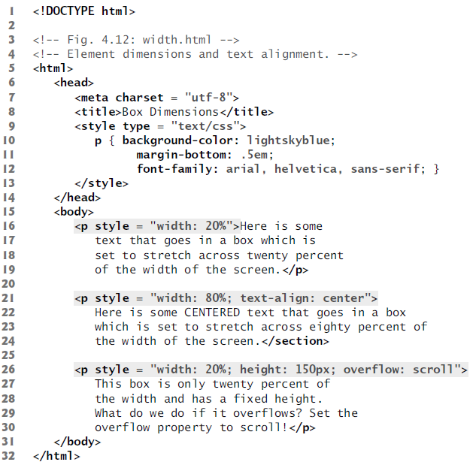
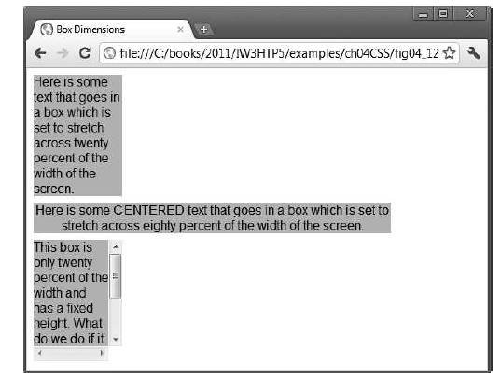

Slide 19
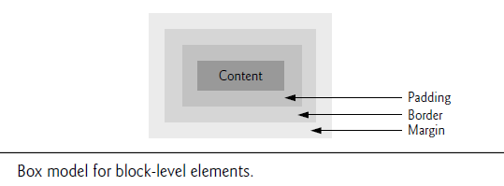
Box Model and Text Flow
All block-level HTML5 elements have a virtual box drawn around them, based on what is known as the box model.
When the browser renders an element using the box model, the content is surrounded by padding, a border and a margin (Fig. 4.13).
CSS controls the border using three properties: border-width, border-color and border-style.

Slide 20
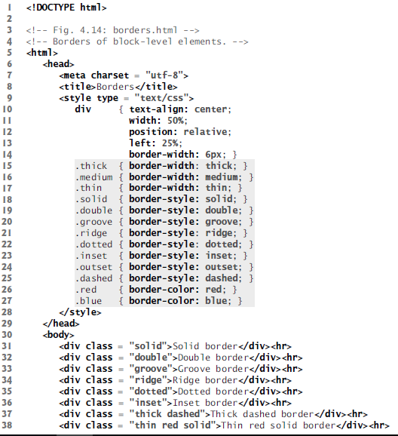
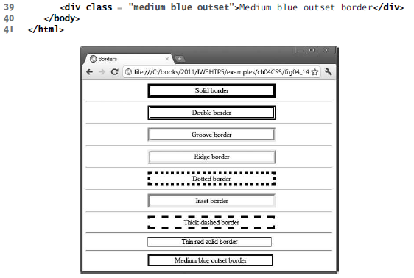

Slide 21
The border-width property may be set to any valid CSS length (e.g., em, ex, px) or to the predefined value of thin, medium or thick.
The border-color property sets the color.
The border-style options are none, hidden, dotted, dashed, solid, double, groove, ridge, inset and outset.

Slide 22
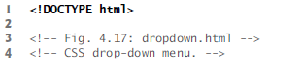
Drop-Down Menus
Drop-down menus are a good way to provide navigation links without using a lot of screen space.
The :hover pseudo-class used to change a link’s style when the mouse hovers over it.
The display property allows you to decide whether an element is rendered on the page or not.
Possible values include block, inline and none.
The block and inline values display the element as a block element or an inline element, while none stops the element from being rendered.

Slide 23

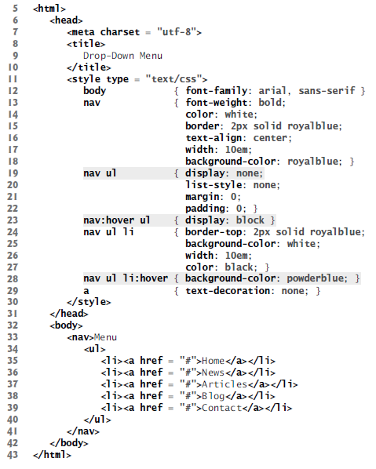
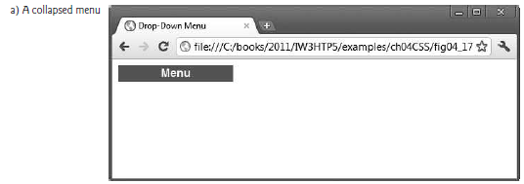
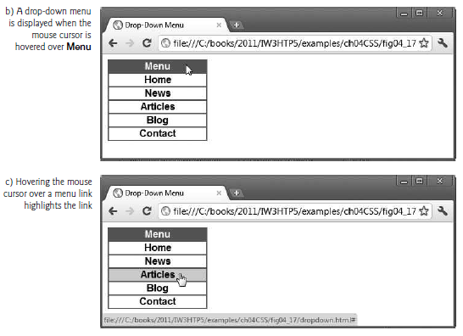

Slide 24
Text Shadows
The CSS3 text-shadow property has four values: -4px, 4px, 6px and DimGrey, which represent:
Horizontal offset of the shadow—the number of pixels that the text-shadow will appear to the left or the right of the text. A negative value moves the text-shadow to the left; a positive value moves it to the right.
Vertical offset of the shadow—the number of pixels that the text-shadow will be shifted up or down from the text. A negative value moves the shadow up, whereas a positive value moves it down.
blur radius—the blur (in pixels) of the shadow. A blur-radius of 0px would result in a shadow with a sharp edge (no blur). The greater the value, the greater the blurring of the edges.
color—determines the color of the text-shadow.

Slide 25
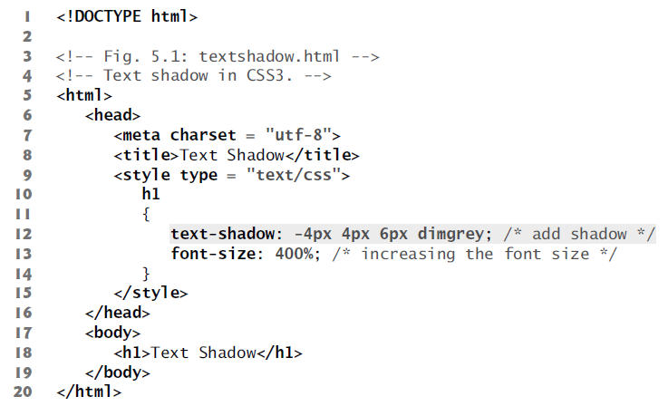
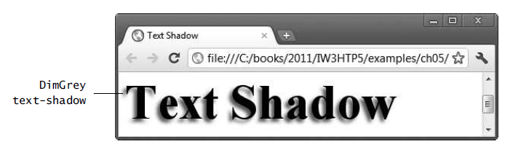

Slide 26
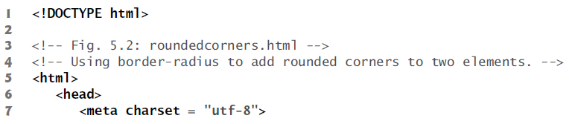
Rounded Corners
allows you to add rounded corners to an element.
Solid Navy borders adds slightly rounded corners to the rectangle.
We increase the border-radius to 50px, making the left and right sides completely round.
We can also specify the radius for each corner with border-top-left-radius, border-top-right-radius, border-bottom- left-radius and border-bottom-right-radius.

Slide 27
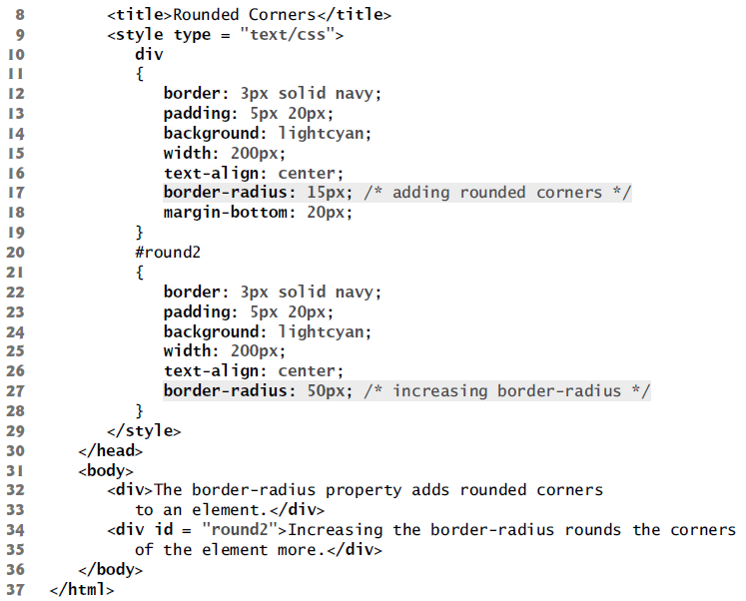
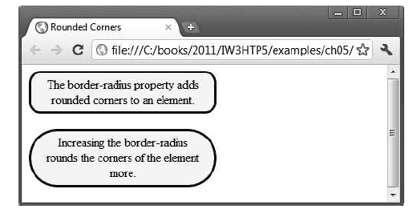

Slide 28
Color
CSS3 allows you to express color in several ways in addition to standard color names (such as Aqua) or hexadecimal RGB values (such as #00FFFF for Aqua).
RGB (Red, Green, Blue) or RGBA (Red, Green, Blue, Alpha) gives you greater control over the exact colors in your web pages.
The value for each color—red, green and blue—can range from 0 to 255.
The alpha value—which represents opacity—can be any value in the range 0.0 (fully transparent) through 1.0 (fully opaque).
background: rgba(255, 0, 0, 0.5);
CSS3 also allows you to express color using HSL (hue, saturation, lightness) or HSLA (hue, saturation, lightness, alpha) values.
The hue is a color or shade expressed as a value from 0 to 359 representing the degrees on a color wheel (a wheel is 360 degrees).

Slide 29
The colors on the wheel progress in the order of the colors of the rainbow—red, orange, yellow, green, blue, indigo and violet.
The saturation— the intensity of the hue—is expressed as a percentage, where 100% is fully saturated (the full color) and 0% is gray.
Lightness—the intensity of light or luminance of the hue— is also expressed as a percentage.
background: hsla(0, 100%, 50%, 0.5);
The resulting color would be a half-opaque red.

Slide 30
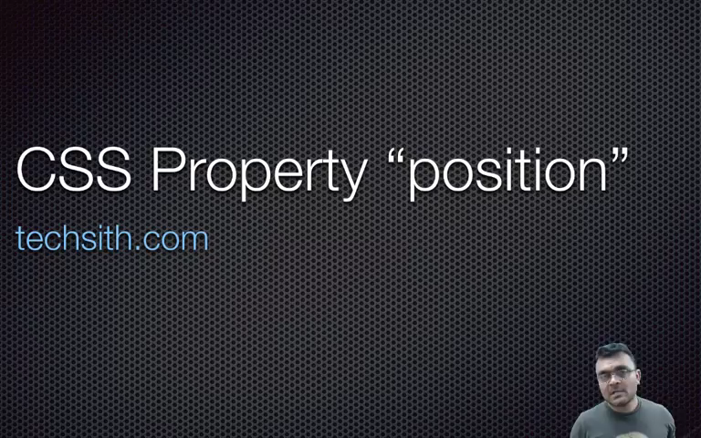
CSS POSITIOniNG

Slide 31
CSS – Box Model and Position Property
Length Units
CSS has several different units to represent lengths.
Most CSS properties take length values, such as width, margin, padding, font-size, etc.
Each length value is followed by a length unit.
Negative lengths are allowed only for some CSS properties only.

Slide 32
CSS – Box Model and Position Property
Length Units
Absolute length units
These are fixed and the length expressed in this format will appear of the same size
Unit | Description | Calculation
cm | centimeters | 1cm = 96px/2.54
mm | millimeters | 1mm = 1/10th of 1cm.
in | inches | 1in = 2.54cm = 96px
px | pixels | 1px = 1/96th of 1in.
pt | points | 1pt = 1/72nd of 1in
pc | picas | 1pc = 12pt = 1/6th of 1in

Slide 33
CSS – Box Model and Position Property
Length Units
Relative length units
Relative length expressed in this format will appear relative to other reference elements
Unit | Description
em | Relative to the font-size of the element (2em is 2 times current font)
ex | Relative to the x-height of current font
ch | Relative to width of the “0” (zero)
rem | Relative to the font-size of the root element
% | Relative to the parent element

Slide 34
THANK YOU
Vinay Joshi
Department of Computer Science and Engineering
vinayj@pes.edu
+91 80 2672 6622

